Slide 1
Feedback Control Systems (FCS)
Lecture-8-9
Block Diagram Representation of Control Systems
Dr. Imtiaz Hussain
email: imtiaz.hussain@faculty.muet.edu.pk
URL :http://imtiazhussainkalwar.weebly.com/

Slide 2
Introduction
A Block Diagram is a shorthand pictorial representation of the cause-and-effect relationship of a system.
The interior of the rectangle representing the block usually contains a description of or the name of the element, gain, or the symbol for the mathematical operation to be performed on the input to yield the output.
The arrows represent the direction of information or signal flow.

Slide 3
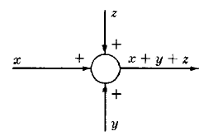
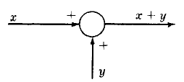
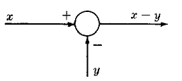
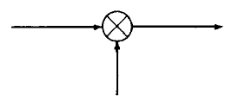
Introduction
The operations of addition and subtraction have a special representation.
The block becomes a small circle, called a summing point, with the appropriate plus or minus sign associated with the arrows entering the circle.
The output is the algebraic sum of the inputs.
Any number of inputs may enter a summing point.
Some books put a cross in the circle.

Slide 4
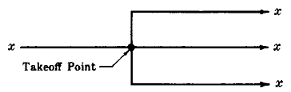
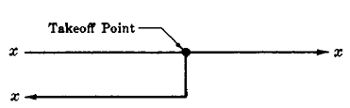
Introduction
In order to have the same signal or variable be an input to more than one block or summing point, a takeoff (or pickoff) point is used.
This permits the signal to proceed unaltered along several different paths to several destinations.

Slide 5

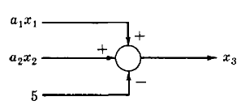

Example-1
Consider the following equations in which $x_{1}$, $x_{2}$, $x_{3}$, are variables, and $a_{1}$, $a_{2}$ are general coefficients or mathematical operators.

Slide 6
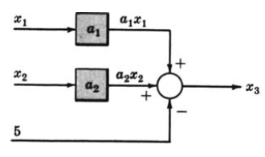
Example-1

Slide 7
Example-2
Draw the Block Diagrams of the following equations.

Slide 8
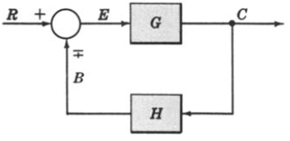
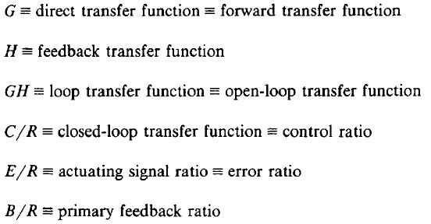



Canonical Form of A Feedback Control System

Slide 9
Characteristic Equation
The control ratio is the closed loop transfer function of the system.
The denominator of closed loop transfer function determines the characteristic equation of the system.
Which is usually determined as:

Slide 10
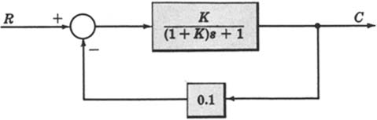
Example-3
Open loop transfer function
Feed Forward Transfer function
control ratio
feedback ratio
error ratio
closed loop transfer function
characteristic equation
Open loop poles and zeros if 9. closed loop poles and zeros if K=10.

Slide 11
Reduction techniques
1. Combining blocks in cascade
2. Combining blocks in parallel

Slide 12
3. Eliminating a feedback loop

Slide 13
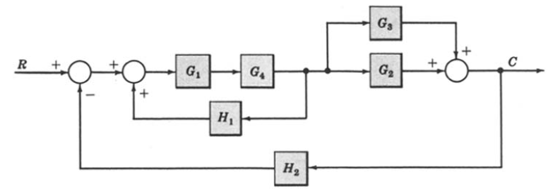
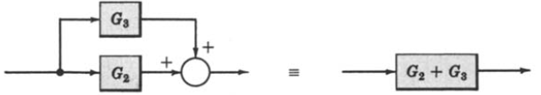
Example-4: Reduce the Block Diagram to Canonical Form.

Slide 14
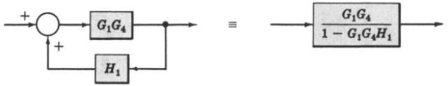
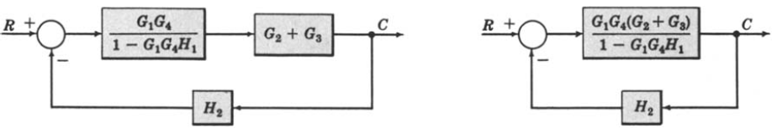
Example-4: Continue.

Slide 15
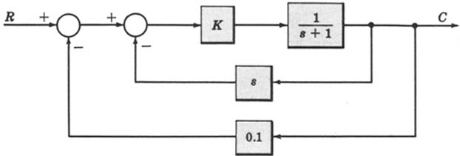
Example-5
For the system represented by the following block diagram determine:
Open loop transfer function
Feed Forward Transfer function
control ratio
feedback ratio
error ratio
closed loop transfer function
characteristic equation
closed loop poles and zeros if K=10.

Slide 16
Example-5
First we will reduce the given block diagram to canonical form

Slide 17
Example-5

Slide 18
Example-5 (see example-3)
Open loop transfer function
Feed Forward Transfer function
control ratio
feedback ratio
error ratio
closed loop transfer function
characteristic equation
closed loop poles and zeros if K=10.

Slide 19
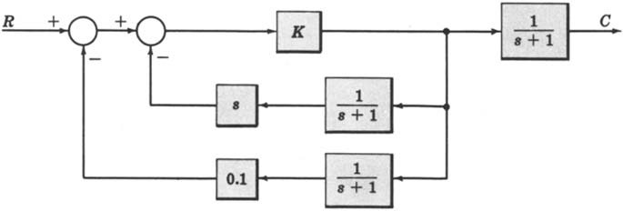
Example-6
For the system represented by the following block diagram determine:
Open loop transfer function
Feed Forward Transfer function
control ratio
feedback ratio
error ratio
closed loop transfer function
characteristic equation
closed loop poles and zeros if K=100.

Slide 20
Reduction techniques
4. Moving a summing point behind a block
5. Moving a summing point ahead a block

Slide 21
6. Moving a pickoff point behind a block
7. Moving a pickoff point ahead of a block

Slide 22
8. Swap with two neighboring summing points

Slide 23
Example-7
Reduce the following block diagram to canonical form.
_
+
_
+
+
+

Slide 24
Example-7
_
+
+
+
_
+

Slide 25
Example-7
_
+
+
+
_
+

Slide 26
Example-7
_
+
_
+
+
+

Slide 27
Example-7
_
+
_
+

Slide 28
Example-7
_
+
_
+

Slide 29
Example-7
+
_

Slide 30
Example 8
Find the transfer function of the following block diagram
R
(
s
)

Slide 31
Solution:
1. Moving pickoff point A ahead of block
2. Eliminate loop I & simplify

Slide 32
3. Moving pickoff point B behind block

Slide 33
4. Eliminate loop III

Slide 34
Example 9
Find the transfer function of the following block diagrams

Slide 35
Solution:
1. Moving pickoff point A behind block

Slide 36
2. Eliminate loop I and Simplify
feedback
Not feedback

Slide 37
3. Eliminate loop II & IIII

Slide 38
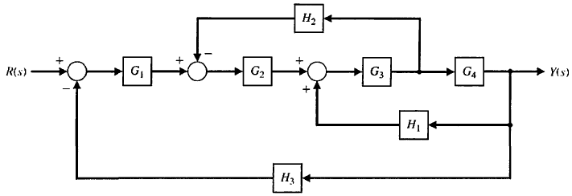
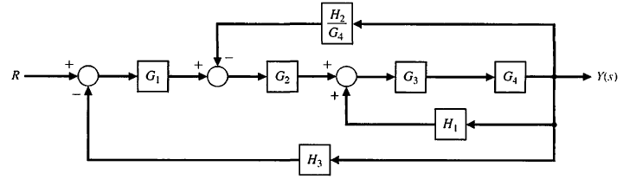
Example-10: Reduce the Block Diagram.

Slide 39
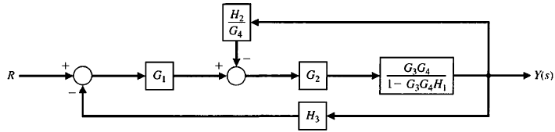
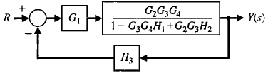

Example-10: Continue.

Slide 40
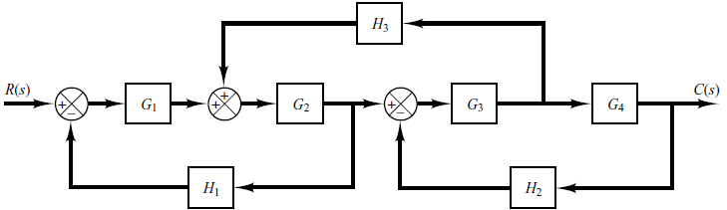
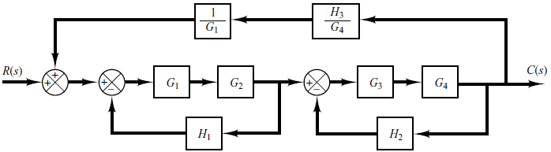
Example-11: Simplify the block diagram then obtain the close-loop transfer function C(S)/R(S). (from Ogata: Page-47)

Slide 41
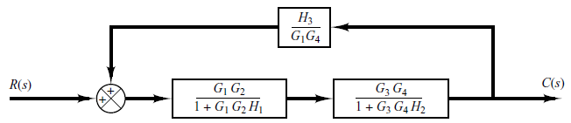

Example-11: Continue.

Slide 42
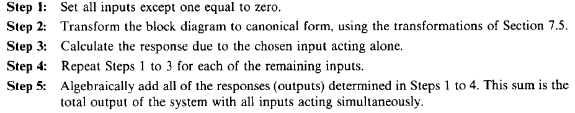
Superposition of Multiple Inputs

Slide 43
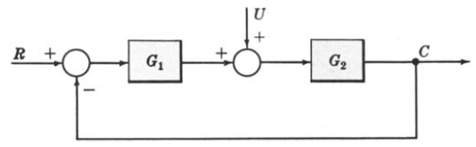

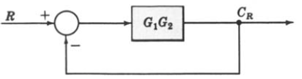
Example-12: Multiple Input System. Determine the output C due to inputs R and U using the Superposition Method.

Slide 44
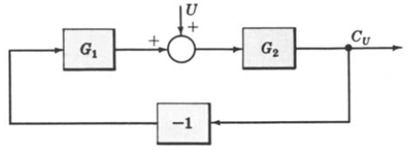
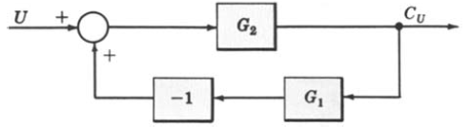
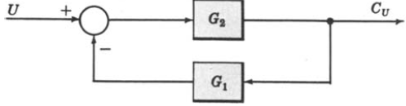
Example-12: Continue.

Slide 45


Example-12: Continue.

Slide 46
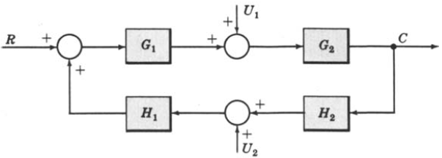
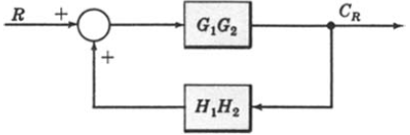
Example-13: Multiple-Input System. Determine the output C due to inputs R, U1 and U2 using the Superposition Method.

Slide 47
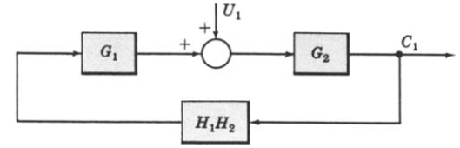
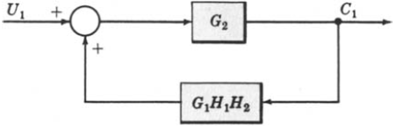
Example-13: Continue.

Slide 48
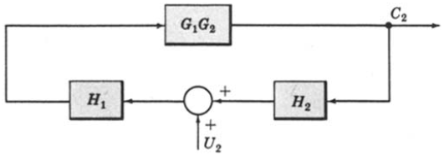
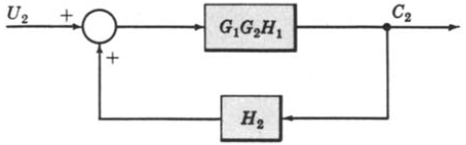

Example-13: Continue.

Slide 49
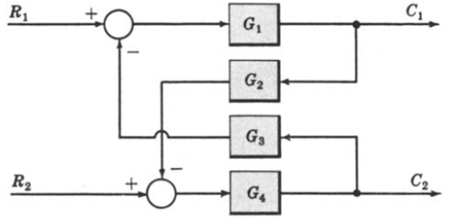
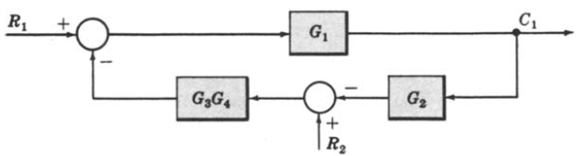
Example-14: Multi-Input Multi-Output System. Determine C1 and C2 due to R1 and R2.

Slide 50
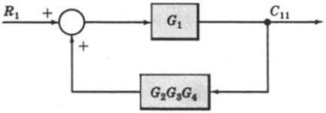
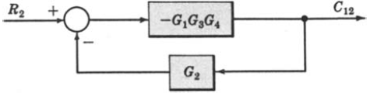
Example-14: Continue.

Slide 51
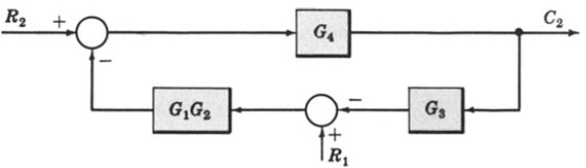
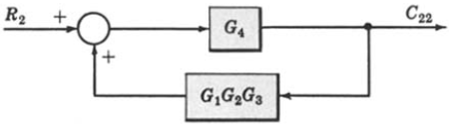
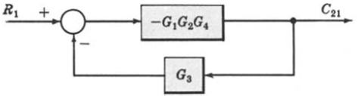
Example-14: Continue.
When R1 = 0,
When R2 = 0,

Slide 52
Block Diagram of Armature Controlled D.C Motor
R_{a}
L_{a}
c
i_{a}
V_{a}
e_{b}
T
J
ω
V_{f}=constant

Slide 53
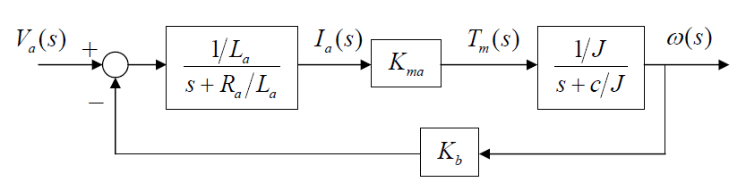
Block Diagram of Armature Controlled D.C Motor

Slide 54
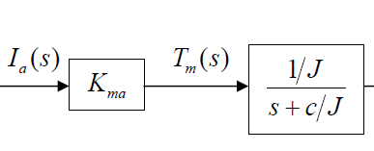

Block Diagram of Armature Controlled D.C Motor

Slide 55
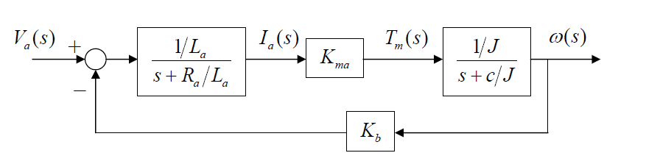
Block Diagram of Armature Controlled D.C Motor

Slide 56
End of Lectures-8-9
To download this lecture visit
http://imtiazhussainkalwar.weebly.com/

